Slide 1

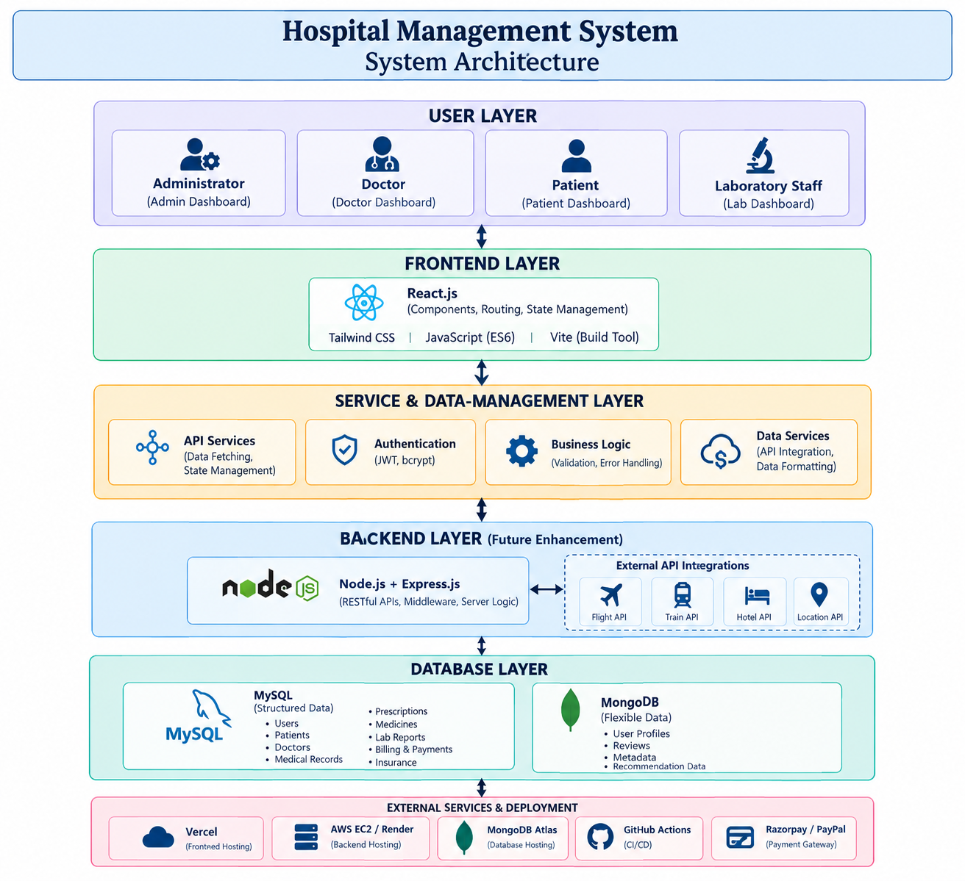
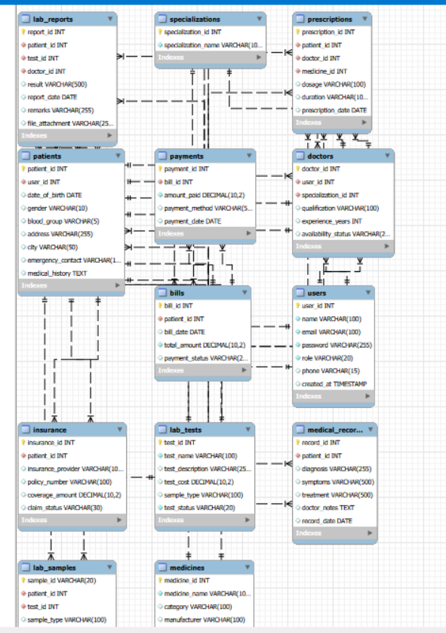
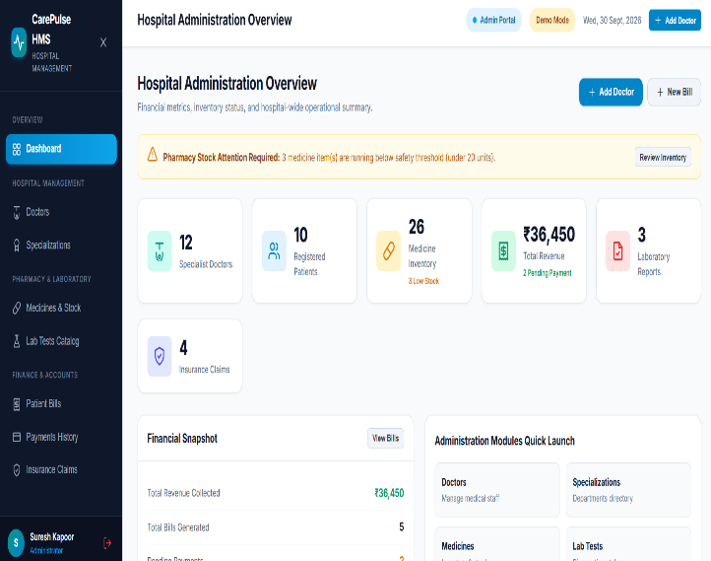
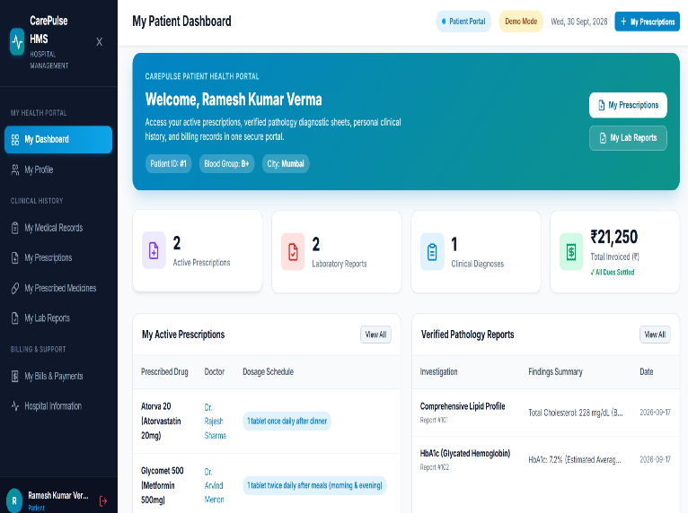
Hospital Management System
Team ID: ______ | Section: ____ | Members: Gandu Rishitha – 2520030101, Sree Haasini – 2520030491, A Priya – 2520030492 | Guide: Dr. Y Prasanthi
Database Systems Engineering and Distributed Backend Development (25CS1302E) | KLH University, Bachupally Campus, CSE | PBL 2026-27
Abstract
Tools & Technologies
A centralized, role-based web app managing patients, doctors, records, prescriptions, medicines, lab tests, billing, payments and insurance for four user roles.
Built with React + Vite and a MySQL database to cut manual record-keeping and data-entry errors.
Front-End: React.js, JavaScript, HTML, CSS, Vite
Back-End: Service / data layer with REST-style APIs (Node.js + Express planned)
Database: MySQL (designed with MySQL Workbench)
Tools: Git & GitHub, VS Code, MySQL Workbench, npm
Problem Statement & Objectives
Problem: Hospital data is scattered across paper files and separate systems, causing slow retrieval and duplicate or inconsistent records.
Objective 1: Centralize patient, doctor, record and medicine data.
Objective 2: Digitize lab, billing, payment and insurance work.
Objective 3: Give each role its own dashboard on a MySQL schema.
Scope: Admin, Doctor, Patient, Lab Staff; no appointments.
System Architecture
Existing vs Proposed System
Feature | Existing System | Proposed System
Records | Paper files | Digital modules
Access | One view for all | Role-based dashboards
Lab & Billing | Handled separately | Integrated modules
Data quality | Duplicate entries | MySQL + validation
Gap | Scattered records | Single platform
ER Diagram & Database Design
Feasibility Study
Technical: React, Vite and MySQL – all free tools that run on standard PCs.
Economic: Fully open-source stack; no licensing or hosting cost.
Operational: Simple role-based dashboards; modular code is easy to maintain.
Schedule: Completed within the semester timeline.
Implementation Screenshots
Results & Testing
Conclusion
Future Scope
Forms, dashboards, navigation and role access tested across all modules
Validation, responsive layout, ₹ billing and MySQL schema verified
Centralized, modular HMS with 4 role-based dashboards
Meets objectives: structured data, less manual effort
Node.js/Express backend with secure authentication
Appointments, notifications and analytics
References: [1] React and Vite Documentation [2] MySQL 8.0 Reference Manual [3] Hospital Management System Project Report, KLH University, 2025
QR: GitHub

